Slide 1
Re-Examining the Evidence of the Hercules-Corona-Borealis Great Wall
Sam Christian

Slide 2
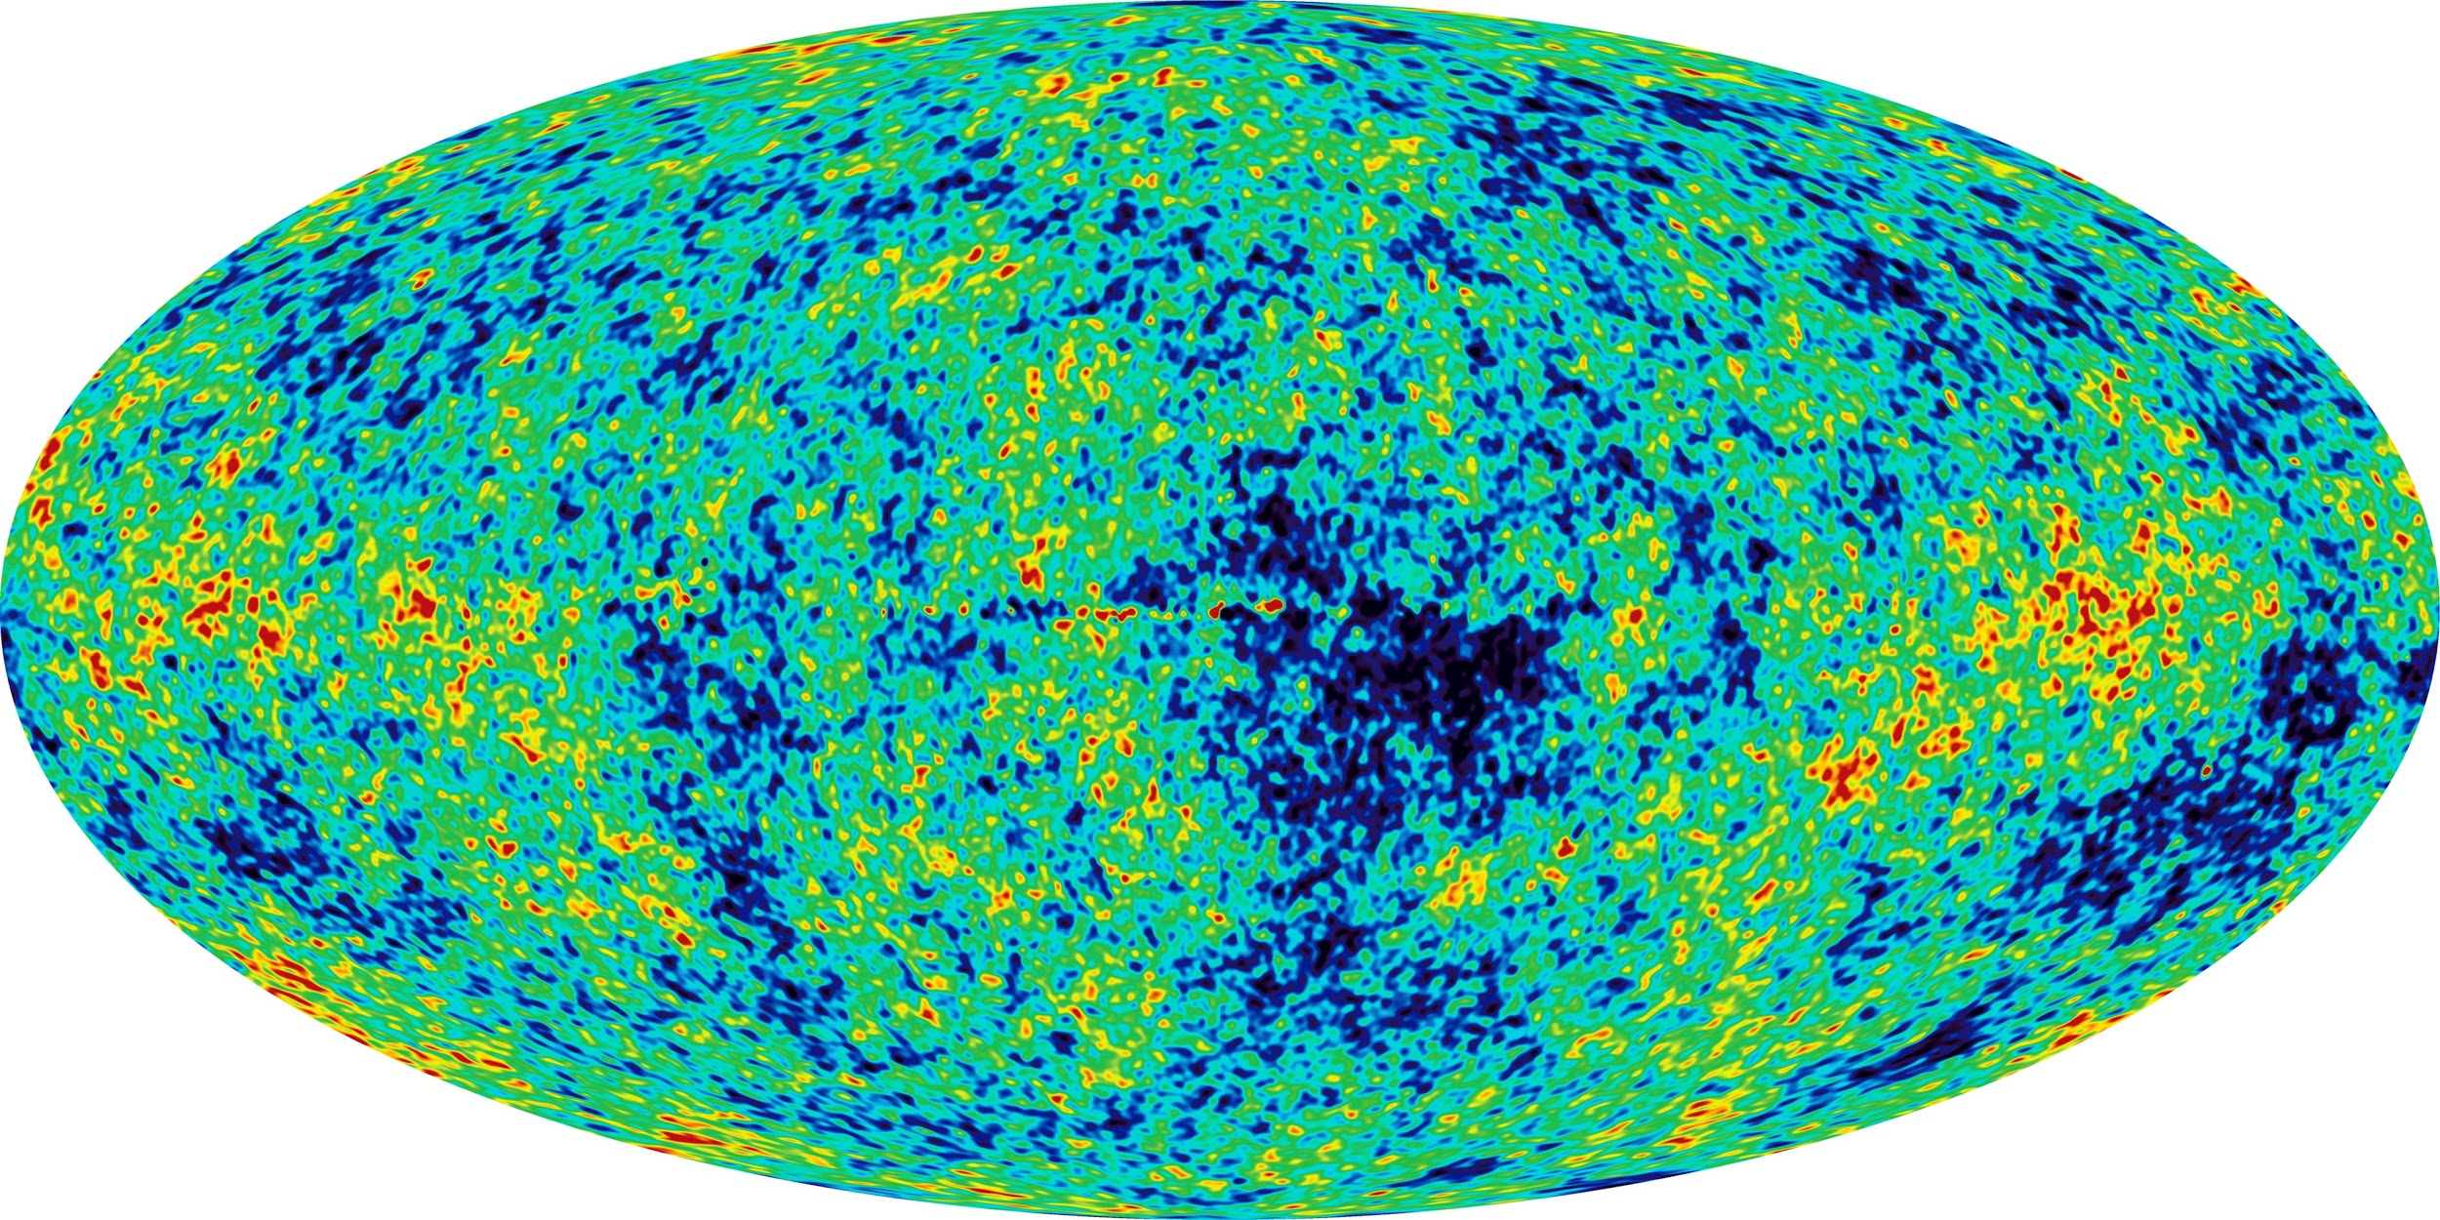
Gamma-Ray Bursts
High energy events: from collapse of star
Very distant: 15818.5 Mpc or 51 Gly
Should be isotropic:
Λ-CDM cosmology.
260 Mpc upper limit (Yadav et al. 2015)

Slide 3
Terms
Redshift: essentially distance
Anisotropy: the opposite of isotropic: typically in one location
Monte-Carlo sampling: essentially means random sampling
1200 lines of code

Slide 4
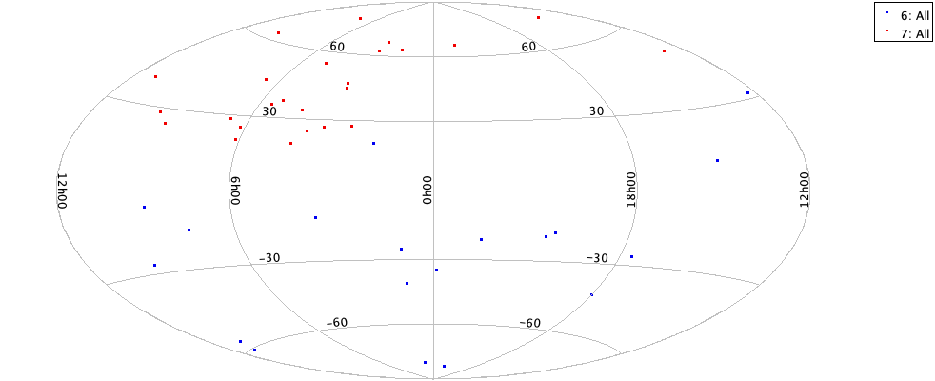
Hercules-Corona-Borealis Great Wall
HCB. ~10⁹ light years away and 10⁹ across
Found in specific redshift range (1.6 to 2.1)
Largest structure in the universe
Notes:
Some tests show significance. All it is is anisotropy in the sky.

Slide 5
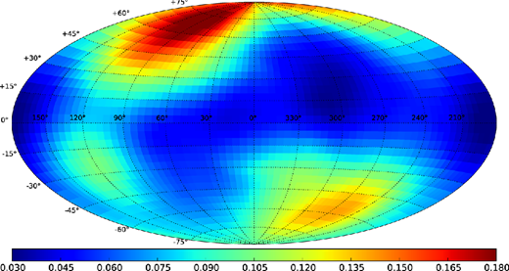
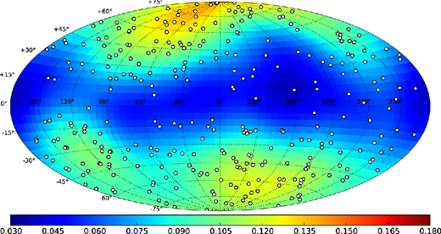
(Ukwatta and Wozniak, 2016)
Notes:
Different data set

Slide 6
No Consensus
Go back to original methods
See if probabilities are actually higher (Monte Carlo methods)
Test on updated sample

Slide 7
Data Sets Used
Previous sample: 361 GRBs, 44 in suspect range. Most from Swift.
Updated sample: 520 GRBs, 75 in suspect range.

Slide 8
Procedures
Will go through each statistical test
Provide evidence of difference NOT due to coding errors

Slide 9

Randomization of points
Right ascension (RA) is ~ P[0,360) where P is a uniform distribution
Must use the well-known “cosine” correction for declination (dec)
Arrive at formula: dec ~ arcsine(2P-1) where P is a uniform distribution and arcsine returns degree values
Notes:
Find cumulative probability. Cumulative probability is always uniform 0 to 1. This is the integral.

Slide 10

Lowering threshold of significance
P-value testing typically uses 0.05
All nine redshift ranges analyzed in original study
Given importance, should avoid false-positives, keep family-wise error rate at 0.05
“Dunn-Sidak correction”
Significance level should thus be 0.00512
Notes:
0.05 should be used as guidance, not a strict threshold.

Slide 11
Point-radius method
Procedure:
Take random circle in sky
Find number of GRBs within that circle
Repeat and find the circle with maximum number of bursts
Find the distribution using Monte-Carlo sampling
Binomial Probability: from number of bursts within circle
Assumes that circle selected randomly
Number found is 25 in actual sample. Able to reproduce this.
0.0018 to 0.002 when extinction is taken into account. Not significant change though
But close to threshold, so while significant, less so than reported in horvath et. al: 0.0001143 and 2 × 10⁻⁸
Notes:
Horvath et al actually uses Monte Carlo sampling. There’s return lower values. Perhaps because they are drawing points from the already present sample? 10,000 trials run. This took the longest, had to be run overnight (although using python so could’ve been shorter in different programming language)

Slide 12

K-th nearest neighbor test
Calculate distance between each GRB in the sample and every other GRB in the sample
Take the distribution of distances for the k-th nearest neighbor
The maximum k-th nearest neighbor was 31 in Horvath et. al
Compare the distributions of two GRB groups using a Kolmogorv-Smirnoff test
Able to reproduce high level of certainty: 0.9999999
But this is misleading: KS-test can be sensitive to outliers

Slide 13
Kth nearest neighbor test
Best to use Monte Carlo sampling
As before, generate random samples of 44 points, compare distributions
Find KS statistic (and p-value) for each trial
Final probability found of 0.0362. This is over the established family-wise error rate

Slide 14
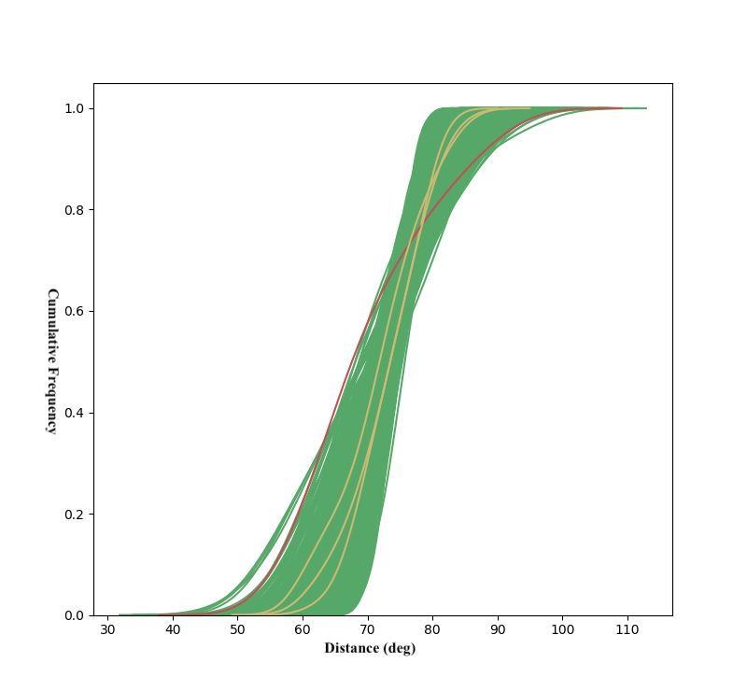

Slide 15
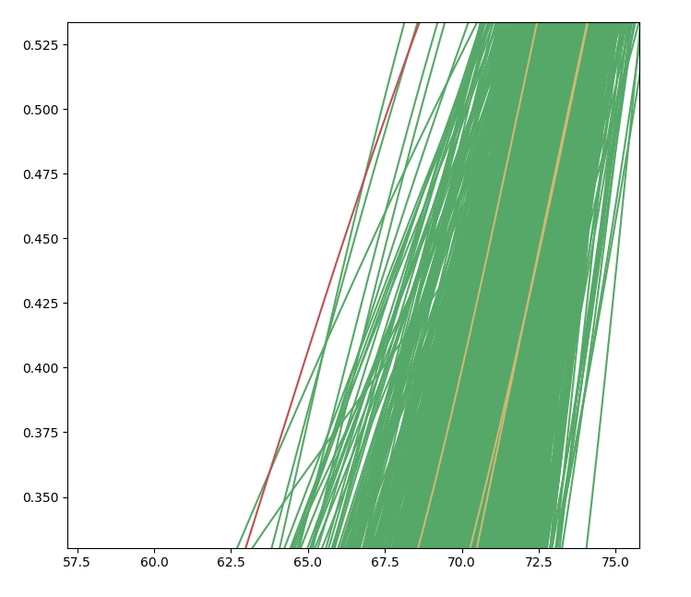

Slide 16
2D KS test
Hard to implement
Orderings arbitrary, must take into account all possible orderings

Slide 17
2D KS test
(Horvath 2014 et. al) also performed 2D KS test
Based off of (Peacock 1983) methedology
NOT performed in (Horvath 2015 et. al)
(Horvath 2014 et. al) used this test with angular differences of samples
Generates 3844 pairs of points
Finds largest difference. This is very sensitive to outliers!
Notes:
Their paper very unclear about this. There is a better way though

Slide 18
2D KS test (my version)
Simply perform KS test on the RA and dec of two samples
Implemented using a package found online: https://github.com/syrte/ndtest
Uses (Fasano and Franceschini 1987) method: a faster 2D-KS method than original
Non-significant values: 0.0641
Obviously not 1 to 1 comparison with (Horvath et al. 2014)
Not as important as other tests as not found in (Horvath et al. 2015)
Notes:
In my opinion, better implementation, but that’s my opinion

Slide 19
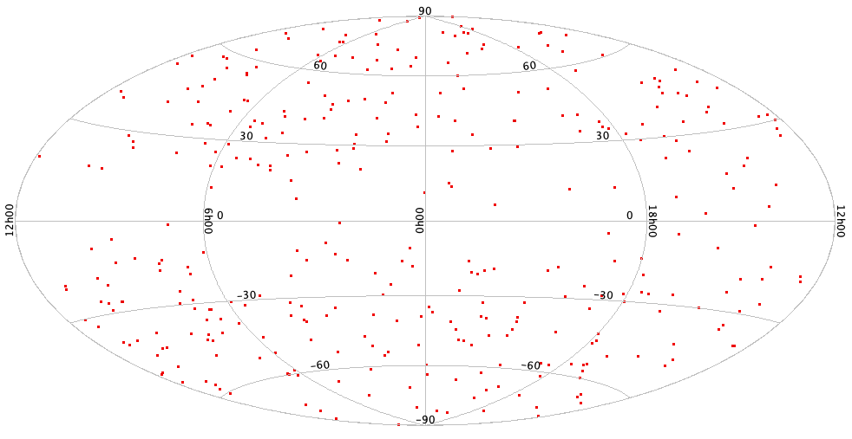
Extinction
Surprised that it didn’t have an effect on the sample
Raised probably by 0.002 in most cases

Slide 20
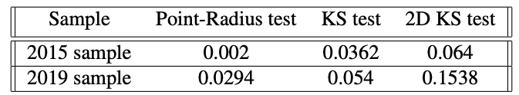
Updated Sample
Used all GRBs located at http://www.mpe.mpg.de/~jcg/grbgen.html
2042 GRBs total, 520 with redshift and 75 in suspect range (1.6 to 2.1)
Performed the exact same tests, no modification
Notes:
Formatting horrible. Lots of manual labor to format all

Slide 21
Updated Sample
All tests, noticeable increase in p-value
In my opinion, most convincing evidence pointing towards the HCB not actually existing

Slide 22
Summary
Modified tests can increase probability (in most cases)
Updated sample vastly increases all probabilities
HCB likely doesn’t exist (because of this paper in conjunction with (Ukwatta and Wozniak, 2016)
Resolves one violation of Λ-CDM

Slide 23
Future Work
Scrutinize other large-scale structures found in GRBs
“Ring-like structure” of Balázs et al. (2015): 2nd largest structure currently known
More GRBs with measured redshifts in the future should ultimately resolve the controversy
Notes:
Not necessarily what I plan to do

